Slide 1

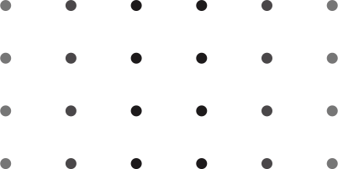




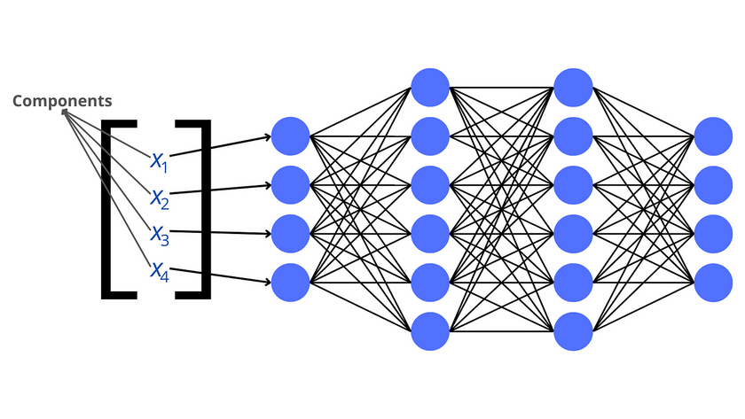




COMPARATIVE ANALYSIS OF DEEPLABV3+ AND
U-NET++ FOR PLANT SEGMENTATION
Guidance by: Mr. K Shivalal Sir, Assistant professor
Date: May 6, 2025
Presented by: Rajesh Yamana (N200721)

Slide 2


Abstract
Objective
The main objective of this project is to compare the performance of two advanced deep learning models. DeepLabV3+ and U-Net++, for plant segmentation in agricultural images. The focus is on accurately segmenting plant diseases by utilizing these models, aiming to improve crop monitoring and disease detection
Review
Recent advancements in semantic segmentation, particularly in agriculture, have leveraged deep learning models for accurate plant and disease identification. Models like DeepLabV3+ and U-Net++ have shown promise in various image segmentation tasks, but their effectiveness in plant segmentation remains a valuable area of research, especially for crop management and disease prevention.

Slide 3
Abstract
Dataset
The dataset used for this project contains images of plants, annotated for segmentation tasks. These images were carefully curated to include different plant species and disease types, ensuring diversity in the training data. The annotations were formatted in the YOLO format, with bounding boxes and segmentation masks created for each plant type.
Efficient PS Architecture
The project compares two efficient Plant Segmentation (PS) architectures: DeepLabV3+, known for its robustness in segmentation tasks using atrous convolution, and U-Net++, which enhances feature reuse and segmentation accuracy
Model Training
Both models, DeepLabV3+ and U-Net++, were trained on the prepared dataset using PyTorch. The training process focused on achieving high segmentation accuracy by adjusting hyperparameters like learning rate, batch size, and number of epochs. Early stopping was implemented to prevent overfitting.

Slide 4
Abstract
Optimization
Model optimization involved using advanced techniques such as data augmentation learning rate scheduling, and early stopping. These methods helped improve model convergence and generalization to new, unseen data.
Evaluation Metrics
To evaluate model performance, IoU,Dice Similarity Coefficient , and Pixel Accuracy were used. These metrics assess the accuracy of the segmentation masks generated by the models compared to the ground truth annotations.
Applications
The results from this comparative analysis can be applied in precision agriculture, where automated plant disease detection can help in timely interventions. It can also be extended to broader applications like crop health monitoring, agricultural robot navigation, and integrated pest management.

Slide 5
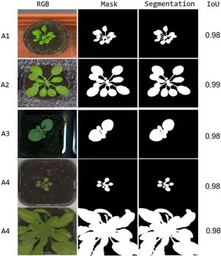


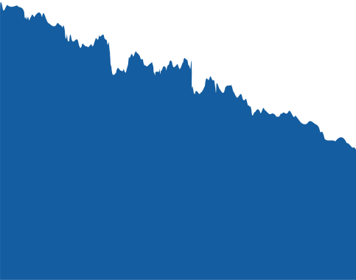
Introduction
In recent years, the agricultural sector has seen significant advancements in automation, driven by artificial intelligence (AI) and machine learning (ML).
One of the key challenges in agriculture is efficient plant monitoring and disease detection, which directly impacts crop health and yield.
Image segmentation, particularly using deep learning models, has emerged as a powerful tool for accurately identifying and segmenting plant diseases.
This project focuses on comparing two deep learning architectures DeepLabV3+ and U-Net++ in the context of plant segmentation.
The objective is to analyze how these models perform on a diverse dataset of plants, comparing their strengths and weaknesses in segmenting various plant species.

Slide 6
Literature Review
Plant segmentation have been crucial research areas in precision agriculture. Traditional methods of plant disease identification often rely on manual inspection, which is time-consuming and prone to human error.
DeepLabV3+ is a cutting-edge semantic segmentation model that utilizes atrous convolution and a decoder module to efficiently capture multi-scale features. It has demonstrated superior performance in various segmentation tasks
On the other hand, U-Net++ is an enhanced version of the original U-Net architecture. U-Net++ introduces nested skip pathways and dense convolution blocks, which improve the flow of information and refine feature extraction, leading to better segmentation accuracy.
Recent studies in agricultural image segmentation have successfully applied these models to detect diseases such as powdery mildew, rust, and blight in crops etc.
This project aims to provide a direct comparative analysis of DeepLabV3+ and U-Net++ for plant segmentation focusing on their strengths and limitations.

Slide 7
Dataset
The dataset used in this project was sourced from the Open Science Framework (OSF), available at: https://osf.io/w9v3j/files/osfstorage.
The dataset consists of 170 high-resolution images, each annotated with bounding boxes for four common plant species
These annotations were originally intended for object detection tasks but were utilized in this project to generate segmentation masks, transforming the dataset for semantic segmentation purposes.
The dataset presents realistic agricultural scenarios with complex backgrounds and plant overlaps, making it ideal for evaluating the performance of advanced segmentation models.

Slide 8

Efficient PS Architecture
In this study, we focused on two state-of-the-art semantic segmentation architectures DeepLabV3+ and U-Net++ for effective plant segmentation from aerial and ground-based images.
DeepLabV3+ builds upon the DeepLab family by incorporating Atrous Spatial Pyramid Pooling (ASPP) and an effective decoder module. ASPP enables the model to capture multi-scale contextual information by applying parallel atrous convolutions with different dilation rates. This helps in identifying both small and large plant structures in diverse field conditions.
U-Net++ enhances the classical U-Net design by introducing nested and dense skip connections between the encoder and decoder stages. These connections bridge the semantic gap between low-level and high-level features, enabling better feature fusion and more precise segmentation.The model is particularly efficient in capturing fine details.

Slide 9
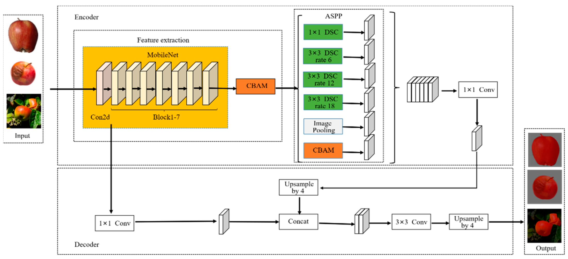

Model Architecture
DeepLabV3+

Slide 10
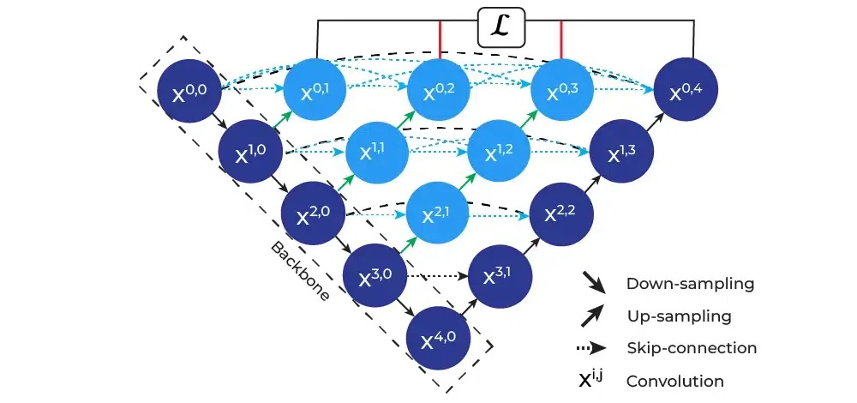
Model Architecture
U-Net++

Slide 11
Model Training and
Optimization
Data Augmentation
Early Stopping
Learning rate
Scheduling
Optimizers

Slide 12



Evaluation Metrics
Intersection over Union (IoU)
Dice Similarity Coefficient
Pixel Accuracy
Measures the overlap between the predicted segmentation mask and the ground truth mask
The Dice Similarity Coefficient (DSC) is a measure of similarity between two sets, commonly used in image segmentation tasks.
Calculates the proportion of correctly classified pixels (both foreground and background) to the total number of pixels.

Slide 13
Metrics Outputs
DeepLabV3 +
U-Net++
Accuracy : 0.9557
Loss : 0.1350
IoU : 0.8096
DSC : 0.8885
Accuracy : 0.9127
Loss : 0.2531
IoU : 0.6116
DSC : 0.7537

Slide 14

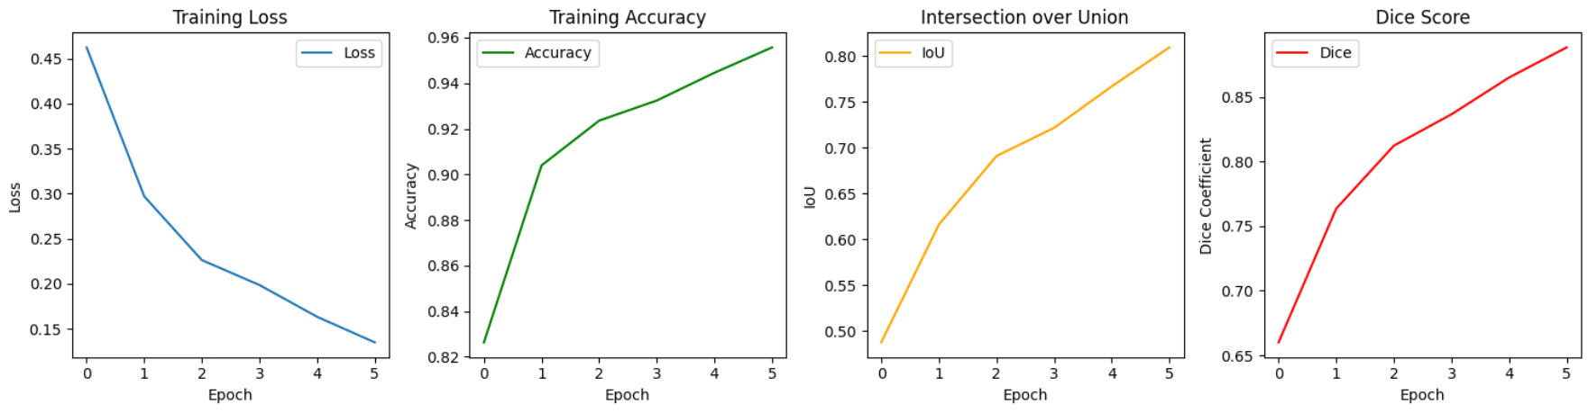
Metric Plots (DeepLab V3+)

Slide 15
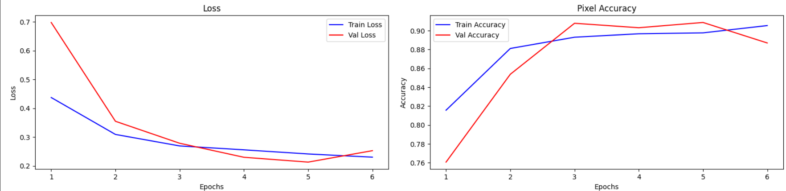
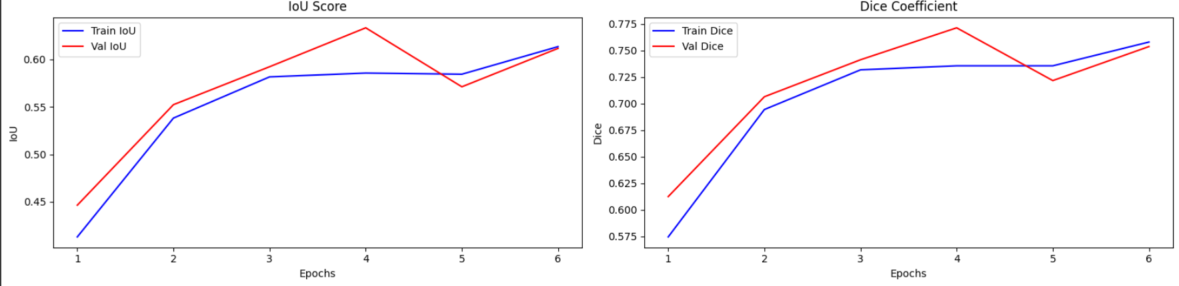
Metric Plots (U-Net++)

Slide 16
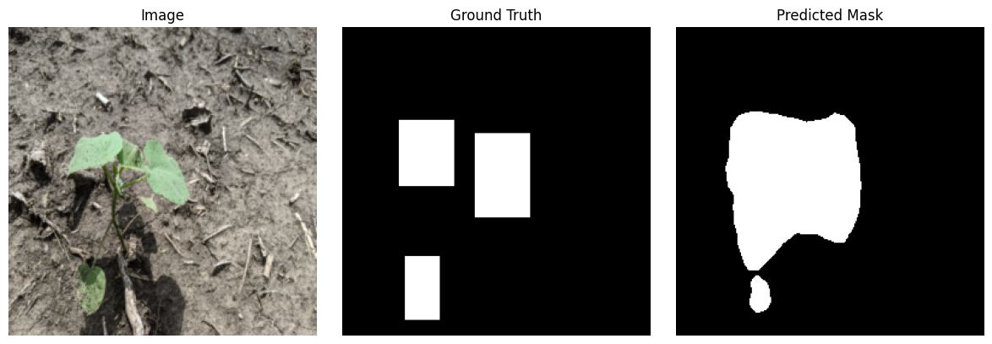
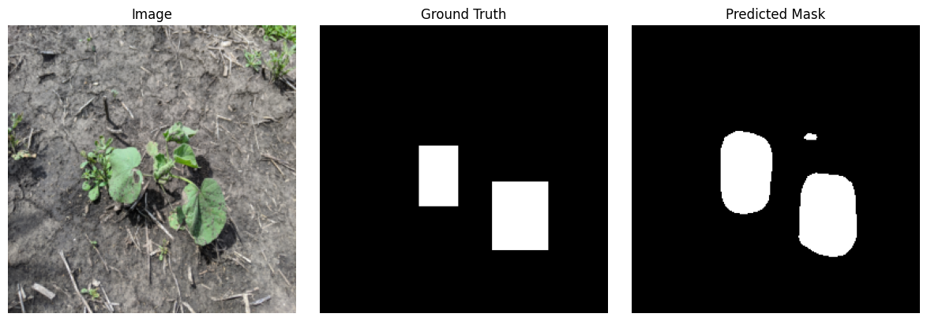
Output images

Slide 17
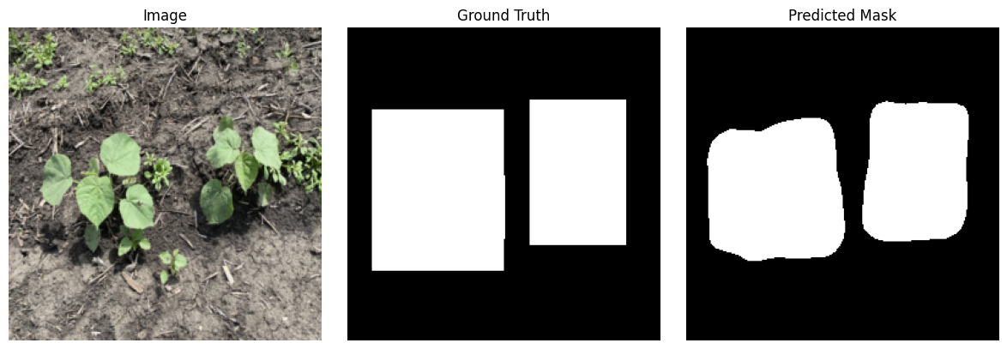
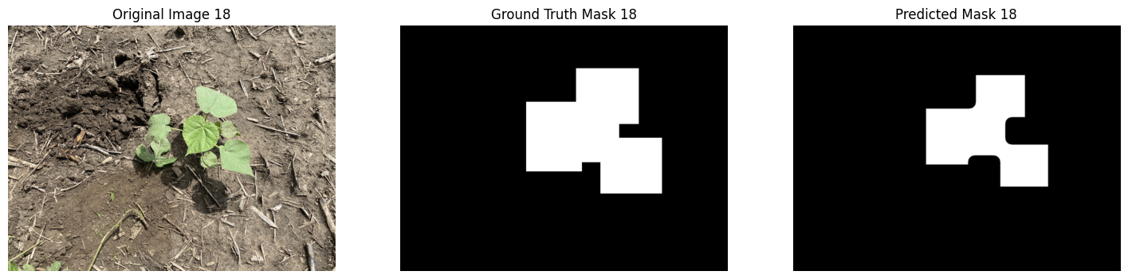
Output images

Slide 18
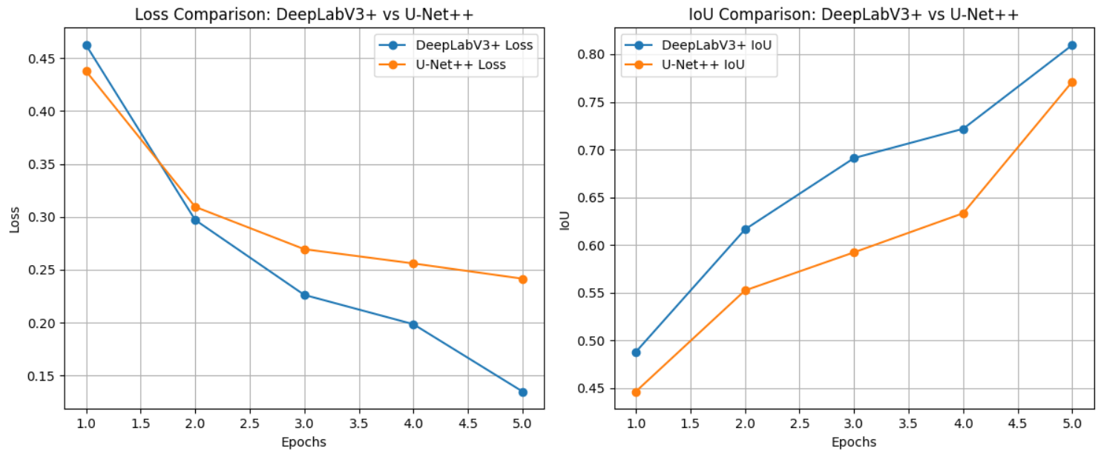
Comparison Plots

Slide 19
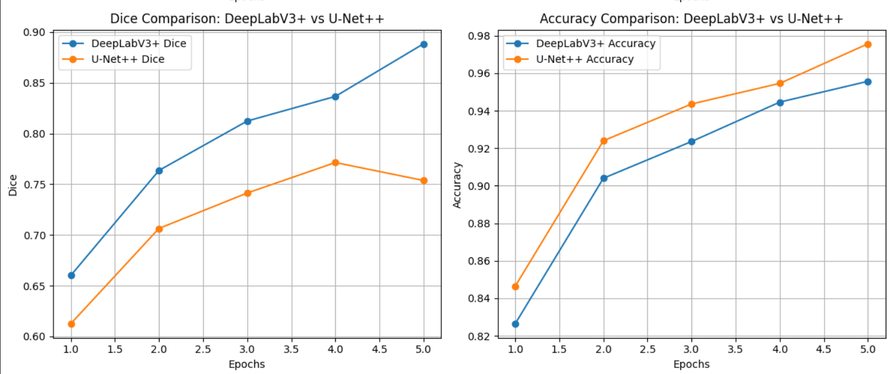
Comparison Plots

Slide 20
Comparision
Feature | DeepLab V3+ | U-Net++
Architecture Type | Encoder-Decoder Atrous Spatial Pyramid Pooling | Encoder-Decoder with nested, dense skip connections
Context Capture | Captures multi-scale context using ASSP | Improves Semantic gap with intermediate dense pathways
Feature Propagation | Relies on deeper encoder features | Enhanced by intermediate layers and short skip connections
Model Flexibility | Easily integrates with various backbones like ResNet | Requires more careful design for deep integration
Performance in this Project | High IoU, good on large-scale features | Slightly better Dice score, effective on small weed regions

Slide 21

Conclusion
This project demonstrated a comparative analysis of DeepLabV3+ and U-Net++ for plant segmentation in crop images. After training and evaluating both models on a custom dataset of 170 images, it was found that:
DeepLabV3+ performed well in capturing large-scale features and showed high IoU scores.
U-Net++ excelled in segmenting fine details and small plant structures, reflected by its higher Dice scores.
Both models proved effective for plant segmentation tasks, and their strengths can be leveraged based on the specific needs of precision agriculture

Slide 22
Applications and
Future Scope
Smart Farming Systems: Integration with drones and robotic systems for real-time plant monitoring and automated weeding.
Agricultural Research : Supports plant phenotyping studies by isolating individual plant structures for analysis.
Crop Health Monitoring : Helps in identifying plant health status and detecting diseases early through visual patterns in segmented regions.
Instance and Panoptic Segmentation: Expanding from semantic segmentation to more detailed object-level segmentation for individual plant instances.
Larger and Diverse Datasets: Training models on more diverse crop types, field conditions, and geographic variations to improve generalizability.

Slide 23
References
ResearchGate Publication:
https://www.researchgate.net/publication/359709813_4Weed_Dataset_Annotated_Imagery_Weeds_Dataset
Dataset Repository (OSF):
https://osf.io/w9v3j/

Slide 24


THANK YOU

